Slide 1
Social Media and Faith
"How to use it without being used by it"

Slide 2
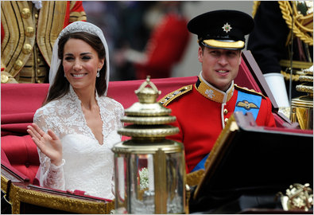
“Who’s the English guy?”

Slide 4
Israel
+
Ireland
+
Norway
+
Sweden
>

Slide 5
“So what?”

Slide 6
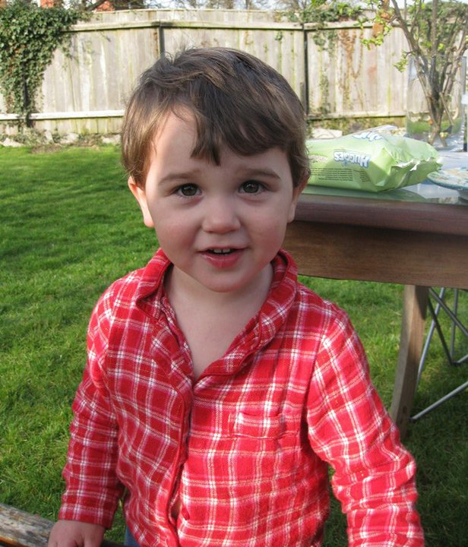
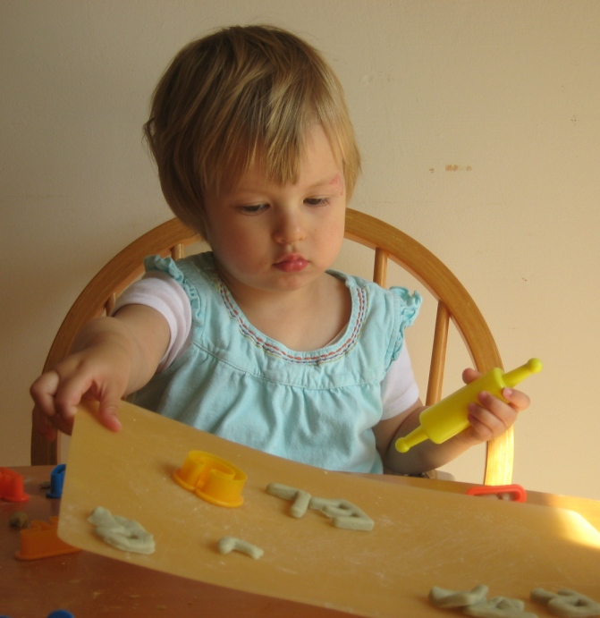
Johnnie
Rachel

Slide 7
“So what as Catholics?”

Slide 8
Pope Benedict
"Church communities have always used the modern media for fostering communication, engagement with society, and, increasingly, for encouraging dialogue at a wider level. Yet the recent, explosive growth and greater social impact of these media make them all the more important for a fruitful priestly ministry"
- 44th World Day of Communications.

Slide 9
What can social media be used for?
(apart from sharing videos of piano-playing cats)
Communication
Friendship
Evangelization

Slide 10
1. Communication
Let us not give up meeting together, as some are in the habit of doing, but let us continue to encourage one another – Hebrews 10:25

Slide 11
2. Friendship
Faithful friends are a sturdy shelter;
whoever finds one finds a treasure.
Faithful friends are beyond price,
no amount can balance their worth.
Faithful friends are life-saving medicine;
those who fear God will find them.
Those who fear the Lord enjoy stable friendship,
for as they are, so will their neighbors be. – Sirach 6:14-17

Slide 12
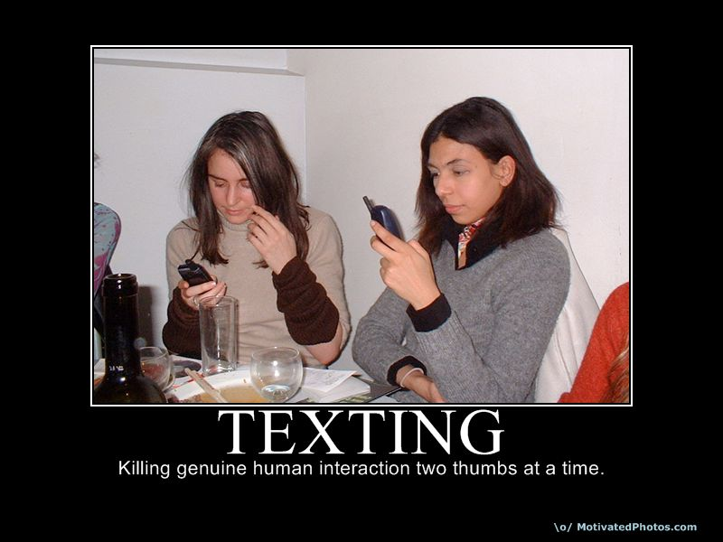

Slide 13
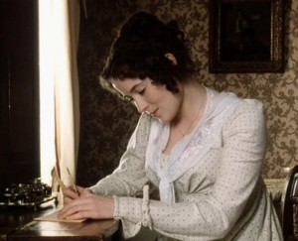
“The soothing tongue is a tree of life,
but a perverse tongue crushes the spirit…” – Proverbs 15:4

Slide 14
3. Evangelization
“We cannot help speaking about what we have seen and heard”
- Acts 4:20

Slide 15
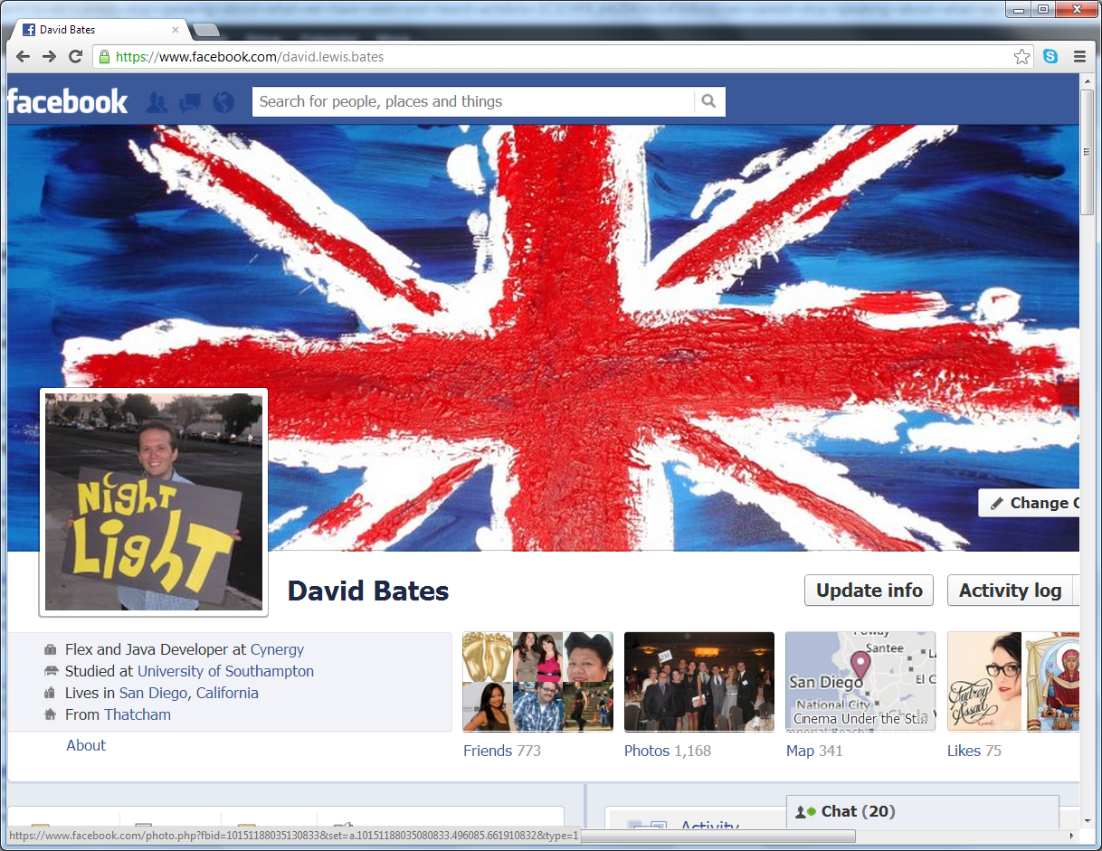
The Only Gospel some people may ever read…

Slide 16
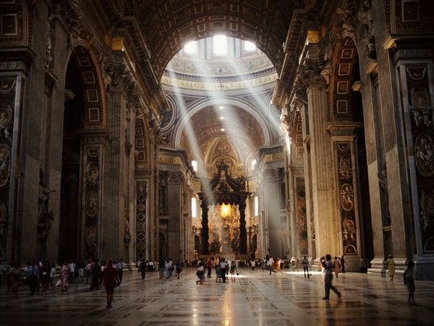
Wisdom, Truth and Beauty of the Church

Slide 17
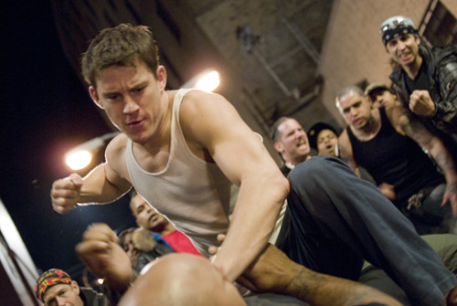
“Always be prepared to give an answer to everyone who asks
you to give the reason for the hope that you have. But do this
with gentleness and respect” – 1 Peter 3:15

Slide 18
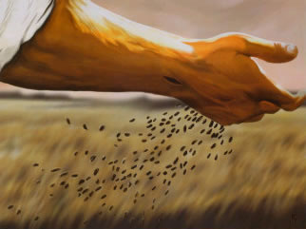
Plant Seeds

Slide 19
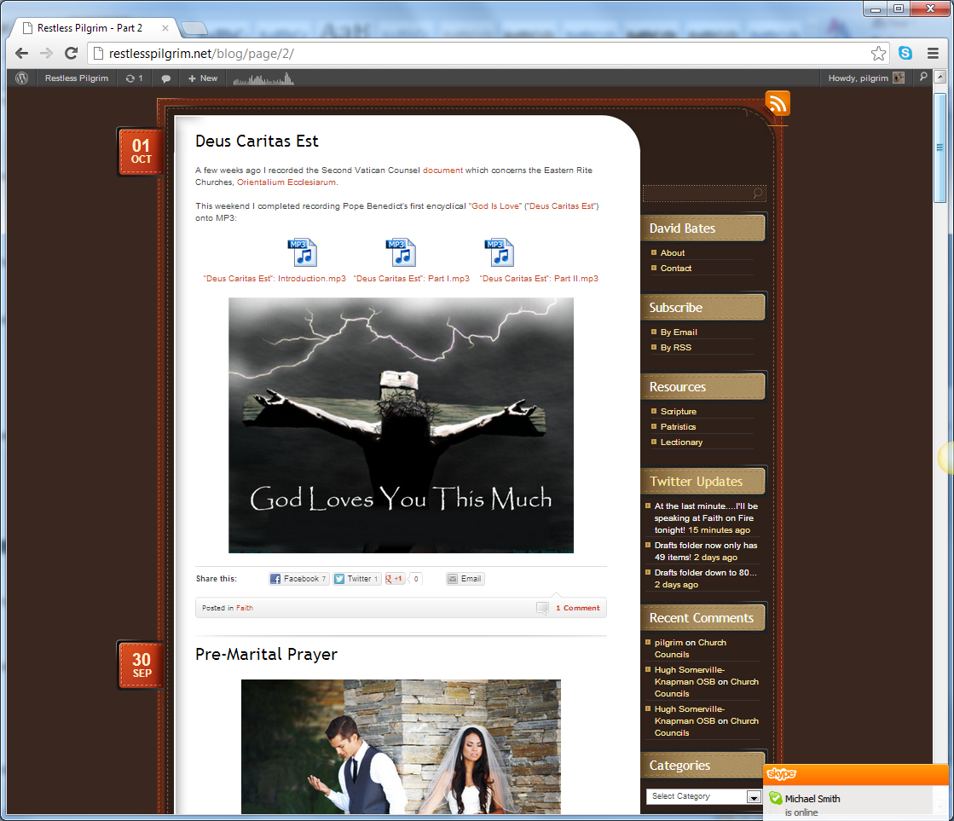

Slide 20
Top Ten Ways…
…to make sure you use social media…
…without getting used by it:

Slide 21
10. Catholic & Proud!

Slide 22
9. What happens in Vegas stays on Facebook,YouTube…

Slide 23
8. Don’t post while hurt or angry

Slide 24
7. Don’t tweet & drive #It Can Wait

Slide 25
6. Don’t be dumb with your smart phone when talking in person

Slide 26
5. Put your phone on vibrate. Always.

Slide 27
4. Consume Catholic Media: Radio (1000AM), quote-a-day sites, blogs and podcasts

Slide 29
3. We have a
(holy) app for that

Slide 30
2. Be a good friend

Slide 31
1. Post one thing a day about Jesus, His Church or your faith

Slide 32
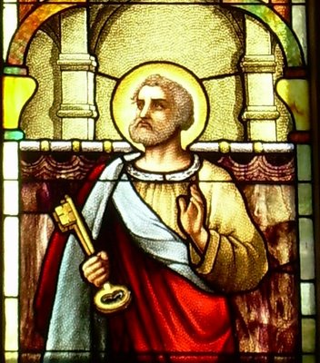

Slide 33
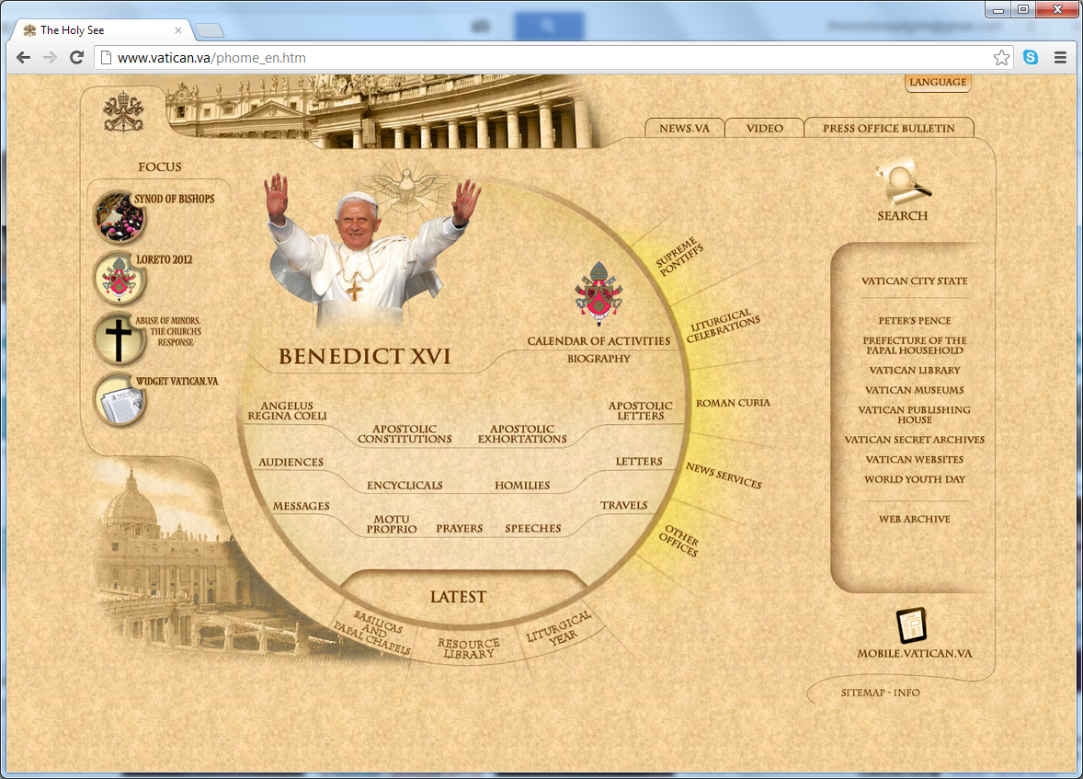

Slide 34
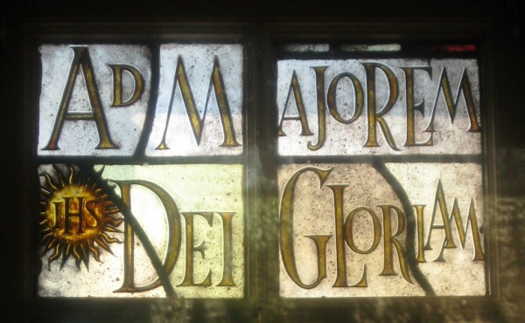

Slide 35
Prayer to St. Isidore of Seville
Almighty and eternal God,
we beseech Thee that,
through the example of St. Isidore,
bishop and doctor,
during our journeys through the Internet
we will direct our hands and eyes
only to that which is pleasing to Thee
and treat with charity and patience
all those souls whom we encounter.
Through Christ our Lord, Amen.

Slide 36
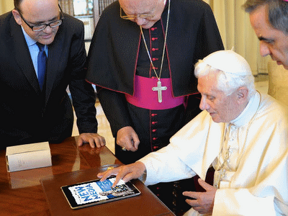
RestlessPilgrim.net
“RestlessPilgrim.net is such a great blog!
Each Catholic should visit every day!”
– Pope Benedict XVI (Unconfirmed Quotation)

Slide 37
Questions
What are your favourite social media sites?
In what way has social media helped nurture your friendships? In what way has it caused problems?
In what way has your faith grown through social media?
What steps can you take to ensure that you use social media and make sure it does not use you?

